Slide 1
ELEMENTARY STATISTICS, BLUMAN
Minimum Sample Size for Proportion
© 2019 McGraw-Hill Education. All rights reserved. Authorized only for instructor use in the classroom. No reproduction or further distribution permitted without the prior written consent of McGraw-Hill Education.

Slide 2
Objectives for this PowerPoint
How to calculate the minimum sample size needed for an interval estimate of a population proportion

Slide 3
Problem
A polling company would like to estimate, to within 2 percentage points, the approval rating of a candidate for an upcoming election. They would like to be 95% confident about their estimate.

Slide 4

Formula
The formula for calculating the sample size necessary for estimating a population proportion with specific precision and confidence includes the z-score associated with the given confidence level and the specified precision.
$$n=\hat{p}\hat{q}{\left(\frac{z_{\frac{α}{2}}}{E}\right)}^{2}$$
Note that the formula also includes the sample proportion estimate of the population proportion. This would not yet be known. This calculation gives us the required sample size. Once that is determined the sample would be drawn and the sample proportion could be determined.

Slide 5
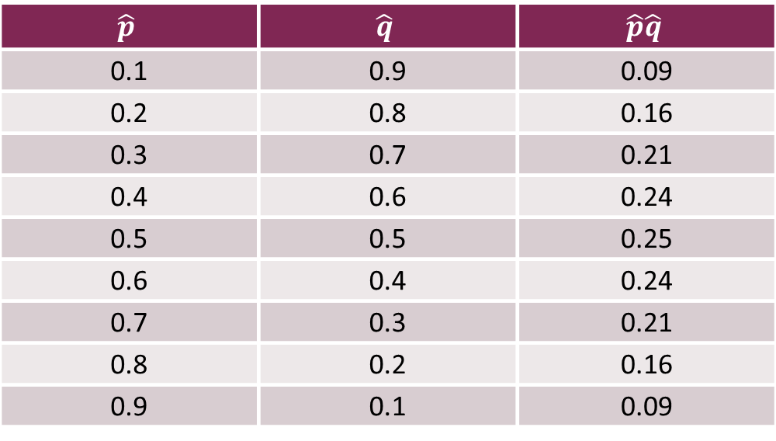

Table of Values
What do we do for the $\hat{p}$ and $\hat{q}$ parts of this formula? If we have the sample proportion for a previous study of the same population then that can be used. But if there is no previous estimate then we must do something else. Let's look at the table that shows the values of $\hat{p}$, and the product of $\hat{p}\hat{q}$.
$$\hat{p}$$ | $$\hat{q}$$ | $$\hat{p}\hat{q}$$
0.1 | 0.9 | 0.09
0.2 | 0.8 | 0.16
0.3 | 0.7 | 0.21
0.4 | 0.6 | 0.24
0.5 | 0.5 | 0.25
0.6 | 0.4 | 0.24
0.7 | 0.3 | 0.21
0.8 | 0.2 | 0.16
0.9 | 0.1 | 0.09

Slide 6


Reliable Estimate
Let's note that the maximum value for the product of $\hat{p}\hat{q}$ is .25. So in the absence of a reliable estimate for $\hat{p}$ the value $\hat{p }$times $\hat{q}$ equal to .25 should be used to give us a sample size that is sufficiently large to guarantee an accurate prediction. The z-score that allows for 95% confidence can be found in a table or found using the TI graphing calculator or any one of many statistical software packages.
The t table shows us on the bottom row that when we desire 95% confidence the associated z score should be 1.96.

Slide 7

Calculation for Sample Size
$$n=\hat{p}\hat{q}{\left(\frac{z_{\frac{α}{2}}}{E}\right)}^{2}$$
$$n=0.25{\left(\frac{1.96}{0.02}\right)}^{2}$$
$$n=2401$$
We find that a sample size of 2401 would allow us to estimate the approval rating for the population with 95% confidence to within two percentage points.

Slide 8
Summary
In this PowerPoint we learned how to calculate the minimum sample size needed for an interval estimate of a population proportion.

